Slide 1

TDR-W Framework
Prioritizing technical debt based on development pain and static costs
Ban Mihai-Constantin

Slide 2

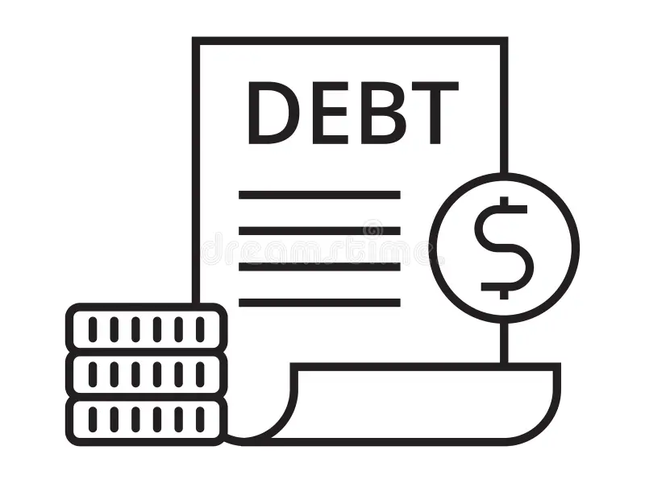
The Problem: Cost vs. Pain
Static metrics are misleading
Traditional tools like SonarQube measure messiness (Cognitive Complexity, Line Counts), but research shows a weak link between these metrics and real delivery delays.
The Flaw: These tools combine the cost to fix with the impact of the problem.
•
Expensive to Fix != Urgent
•
High Cost + Zero Traffic = Benign Debt

Slide 3




Conceptual Framework
The Principal
The Interest
Effort to fix
Development pain
The static, one-time cost to refactor the code. Measured in hours or complexity points.
The ongoing cost of doing nothing. Friction in daily work and bugs affecting customers.
"How hard is it to clean this up?"
"How much is this hurting us right now?"

Slide 4



The TDR-W Formula
Technical Debt Risk (TDR) is calculated by multiplying the static effort by the dynamic pain score.
TDR = (Effort) × (wcommits * Recent Commits + wbugs * Recent Bugs)
wcommits
wbugs
Weight for Friction (ex: 0.5)
Weight for Unreliability (ex: 1.0)

Slide 5






Defining "Pain"
Friction
Unreliability
Measured by Recent Commits
Measured by Recent Bugs
Developers waste ~23% of time working around debt. High rate of change in a complex file indicates a hotspot where time is actively being lost.
Architecture issues correlate with defects. Linking recent bug fixes to specific modules identifies where the product is failing users.

Slide 6



MSR-Based Methodology (Mining Software Repository)
1. Effort Proxy
2. Friction
3. Unreliability
Tool: Lizard (Python)
Tool: PyDriller
Method: HBFM
Calculates NLOC (Nr lines of code) and CCN (Cyclomatic Complexity). Combines them to estimate the physical volume of work required to fix the debt.
Mines the Git history to count Recent commits (last 6 months). Identifies which files are being touched most frequently by the team.
Heuristic-Based Fix-Mapping. Scans commit messages for keywords (ex: "fix", "bug") to approximate where bugs are occurring without complex linking.

Slide 7
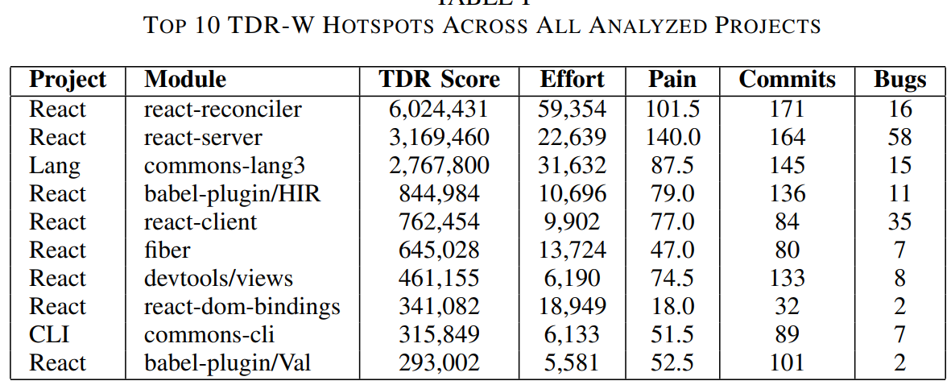
Case Study: Identifying Hotspots
Analysis of the React repository revealed hidden risks. react-server had lower Effort than react-reconciler, but significantly higher pain density.
Despite requiring less effort to fix, react-server caused 140.0 Pain Score vs 101.5, making it a priority target.

Slide 8
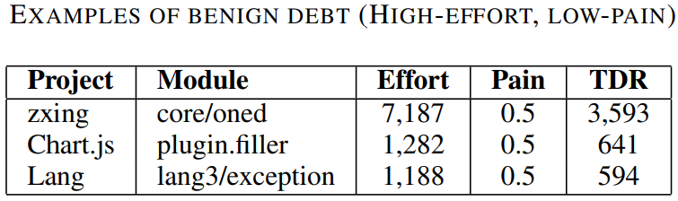
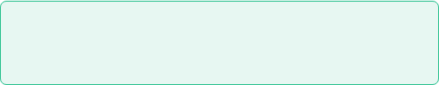
Case Study: Ignoring Benign Debt
High Cost, Zero Impact
The zxing/oned module had a massive Effort score (7,187), which would flag it as critical in standard static analysis tools.
However, TDR-W analysis showed it had almost zero activity (0.5 Pain Score).
0.5
Pain Score
Decision: Safely Ignore. Refactoring this would waste resources with no benefit.
Module: zxing/oned

Slide 9


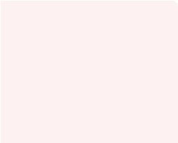
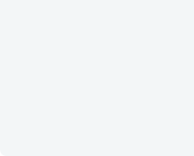


Implications: The Prioritization Matrix
By plotting TDR Score against Business Value, teams can make objective decisions.
High Business value
•
Strategic Core: High Value code that is clean. Keep it that way.
Strategic Core
Critical Fix
Quality code, not much to fix
Immediate Action
•
Critical Fix: High Value code that is actively causing pain. Fix immediately.
•
Benign: Low Value, Low Risk. Ignore.
Benign Debt
Containment
Boundary Discussion: Items sitting close to the axis lines are discussion candidates. A module that is not quite urgent but almost critical might be worth a proactive fix to prevent a future issue
Safe to ignore
Refactor only if touching
Low Business value
Low TDR
Technical Debt Risk (TDR)
High TDR

Slide 10
Conclusion
The TDR-W framework moves Technical Debt management from theoretical model to a practical framework.
Identifies Hotspots
Filters Benign Debt
Aligns with Business
Thank you.

